Slide 1
Employee Data Analysis using Excel
STUDENT NAME: LAVANYA. P
REGISTER NO:122200084
DEPARTMENT:B.COM CORPORATE SECRETARYSHIP
COLLEGE : PACHAIYAPPA'S COLLEGE FOR WOMEN KANCHIPURAM.

Slide 2
PROJECT TITLE
CREATING AN EMPLOYEE PERFORMANCE SCORECARD IN EXCEL

Slide 3


AGENDA
Problem Statement
Project Overview
End Users
Our Solution and Proposition
Dataset Description
Modelling Approach
Results and Discussion
Conclusion
3/21/2024 Annual Review

Slide 4

PROBLEM STATEMENT
To write a problem statement on employee performance, you need to identify the specific area of performance that is problematic, such as low productivity, high absenteeism, or poor quality of work.

Slide 5

PROJECT OVERVIEW
.
This project overview provides a general outline for creating an Employee Performance Scorecard in Excel. The scope, deliverables, timeline, and resources may vary depending on your specific requirements and needs.

Slide 6

WHO ARE THE END USERS?
Human Resources (HR) Managers:
Department Managers/Supervisors:
Senior Management/Executives:
Employees:

Slide 7

OUR SOLUTION AND ITS VALUE PROPOSITION
Solution: Our Employee Performance Scorecard in Excel is a comprehensive and user-friendly tvvl that helps vrganizativns evaluate and track emplvyee performance effectively. The scorecard includes: 1. Customizable KPIs: Align emplvyee gvals with company vbjectives using relevant metrics and targets. 2. Automated Calculativns: Excel formulas and conditional formatting simplify data entry and analysis.
*
Value Proposition: Our Employee Performance Scorecard in Excel vffers numervus benefits, including: 1. Improved Performance Management: Enhance emplvyee evaluativns with data-driven insiglits. 2. Increased Productivity: Streamline the performance management process, saving time and resources.

Slide 8
Dataset Description
*Dataset:* Employee Performance Scorecard *Description:* This dataset contains information used to evaluate and track employee performance. It includes: *Tables:* 1. *Employee Information* - Employee ID (unique identifier) - Name - Job Title - Department - Manager 2. *Performance Metrics* - Metric ID (unique identifier) - Metric Name (e.g., Sales Revenue, Customer Satisfaction) - Target Value - Weightage (importance of the metric) *Data Types:* - Employee ID: integer - Metric ID: integer - Actual Value: numeric - Rating: integer - Goal ID: integer - Evaluation Date: date - Feedback Comments: text - Overall Rating: integer *Relationships:* - An employee can have multiple performance metrics (one-to-many).

Slide 9

THE "WOW" IN OUR SOLUTION
1. *Automated Calculations*: Excel formulas and conditional formatting automatically calculate performance ratings, saving time and reducing errors.
2. *Interactive Dashboards*: Visual charts and graphs provide real-time insights into employee performance, making it easy to identify areas for improvement.
3. *Customizable Templates*: Tailor the scorecard to your organization's specific needs and goals, with flexible templates and adjustable weightages.
4. *Real-time Feedback*: Instant feedback and evaluation capabilities enable timely coaching and development opportunities.
3/21/2024 Annual Review
9

Slide 10
MODELLING
Model Relationship:
1. Employee informativn Performance data (vne-tv-many)
2. Performance metrics Performance data (vne-tv-many)
3. Performance data Calculativn layer (input fvr automated calculation
Model Assumptions:
1. Performance metrics are standardized and consistent across the vrganizativn.
2. Employee performance data is accurate and up-tv-date.
3. Weightages for performance metrics are determined by management vr HR.
10

Slide 11
MODELLING
Model Assumptions: 1. Performance metrics are standardized and consistent across the vrganizativn. 2. Employee performance data is accurate and up-tv-date. 3. Weightages for performance metrics are determined by management vr HR. Model Valuation: 1. Test automated calculations for accuracy and consistency. 2. Verify conditivnal formatting and visual indicators. 3. Review performance summaries and visualizativns fvr insights and trends. 4. Validate scorecard templates and summary reports for accuracy and completeness.
11

Slide 12
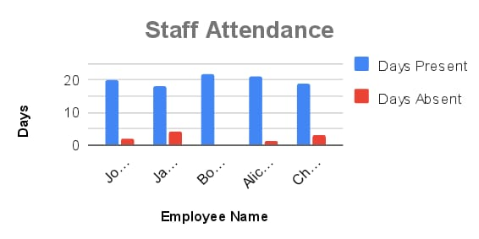
RESULTS
12

Slide 13
conclusion
_Conclusion:_ The Employee Performance Scorecard in Excel is a powerful tool for evaluating and tracking employee performance. By leveraging Excel's capabilities, we have created a comprehensive and user-friendly scorecard that: 1. _Streamlines performance management_: Automates calculations, reduces errors, and saves time. 2. _Provides actionable insights_: Offers real-time feedback, identifies areas for improvement, and supports data-driven decision

